Slide 1
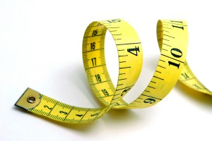
Measures of Summary
Notes:
https://www.utdallas.edu/~scniu/OPRE-6301/documents/What_Is_Statistics.pdf

Slide 2
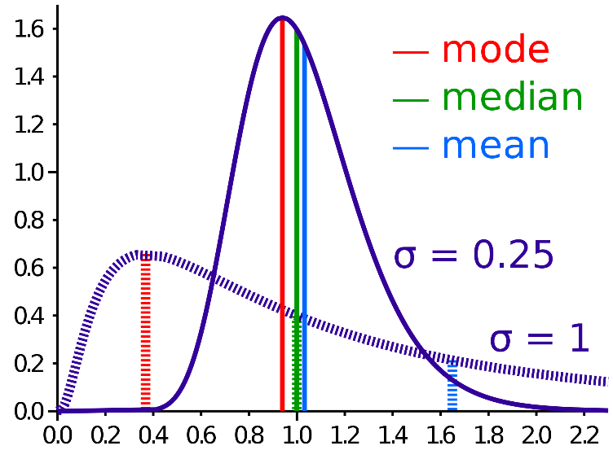
Measures of Summary
Mean
Arithmetic Mean
The sum of observations divided by the total number of observations
Median
Is the "middle" of a sorted list of numbers.
Mode
Refers to the most frequently occurring number found in a set of numbers.

Slide 3

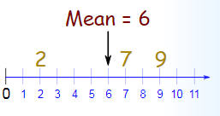
Mean
The mean of a dataset is the numerical average
Can be computed by dividing the sum of all the data points by the number of data points:

Slide 4
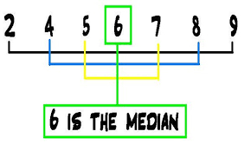
Median
The median of a dataset is the data point that is directly in the middle of the data set.
The median is robust to outliers, therefore an outlier will not affect the value of the median.
Notes:
1. The data set is odd n/2 = the position in the data set the middle value is
2. The data set is even xk+xk+1/n gives the median for the two middle data points

Slide 5
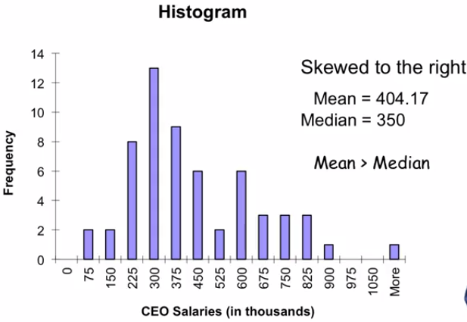
Mean vs Median
Relates to the skewness of data
Histogram shows the skewness of data.
Mean is greater than median in below chart.

Slide 6
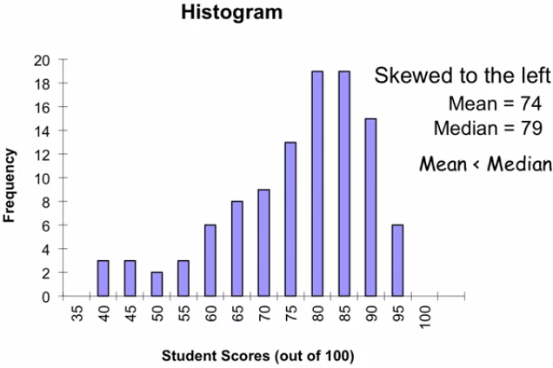
Mean vs Median
Left Skewed Data

Slide 7
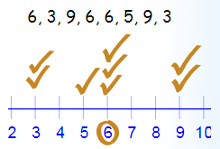
Mode
The most frequently occurring value in a set of data
The mode is robust to outliers as well.
In the normal distribution the mean = median = mode.

Slide 8
Central Tendency

Slide 9


